Slide 1
Project 1 Automatic Light Control System

Slide 2
Project description
This project aims at designing the light control system which operates automatically without human intervention.
It uses the photosensor, in our case Light Dependent Resistor(LDR) which senses the amount of light falling on it.
When the bright light falling on LDR, the microcontroller is programmed in a way that it automatically switches OFF the light(LED).
When the dim light falling on LDR, the microcontroller is programmed in a way that it automatically switches ON the light(LED).

Slide 3
Short notes on Light Dependent resistor(LDR)
LDR also known as photoresistor.
It is a passive component that decreases resistance with respect to the receiving light on the component’s sensitive surface.
The resistance of the photoresistor decreases with the increase of incident light intensity.
In the dark, a photoresistor can have a resistance as high as several megaohms (MΩ), while in the light, a photoresistor can have a resistance as low as a few hundred ohms.

Slide 4
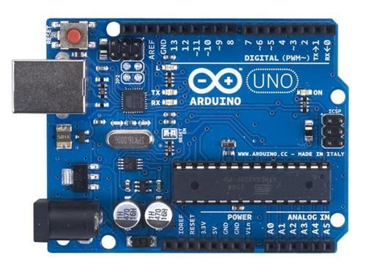
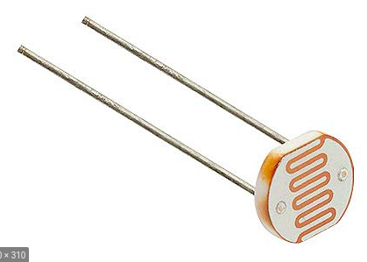
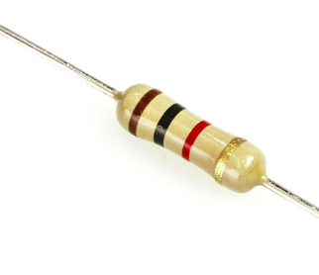
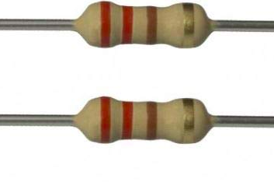
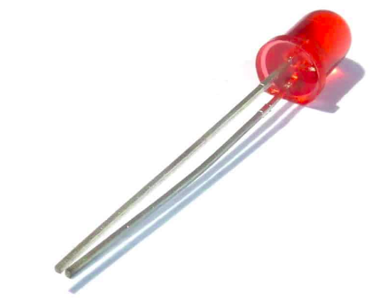
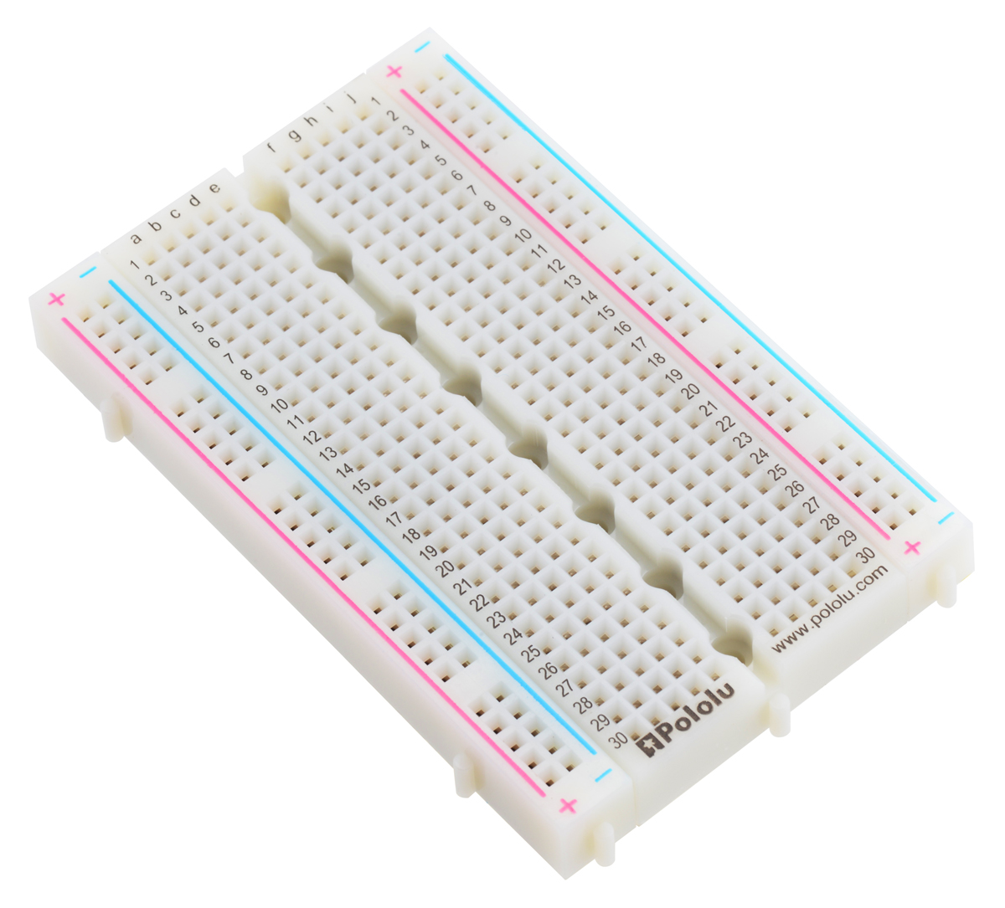
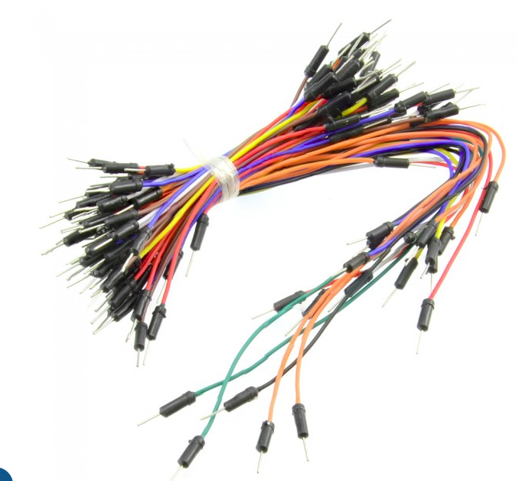
Components to be used
1k ohm
Light Dependent Resistor (LDR)
220 ohms
Arduino UNO R3 board
220 ohms
Light Emitting Diode (LED)
Breadboard
Jumpers

Slide 5
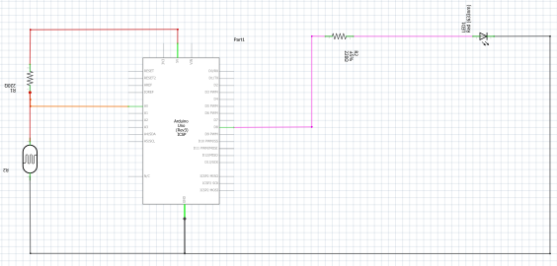
Circuit diagram

Slide 6
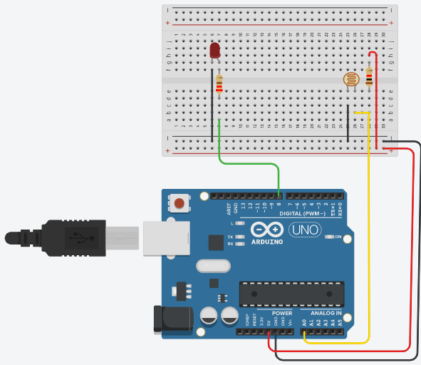

Slide 7
Applications of this project
Street lights.
Home lights to save electric energy usage.
Light intensity meters.
Bulgar alarm circuits.
Alarm clock.

Slide 8


